Slide 1


ECEN 403 Final Presentation SolarEye Security System
Team members: Alex Allahar, Victor Igbokwe, Jackson Kitchel, Zayan Prasla
Sponsor: Dr. Jang

Slide 2

Problem Overview
A solar-powered security system with a motion-detecting camera. This system provides near real-time video feeds and send automated alerts for suspicious activity through a mobile app, enhancing safety in these areas.

Slide 3
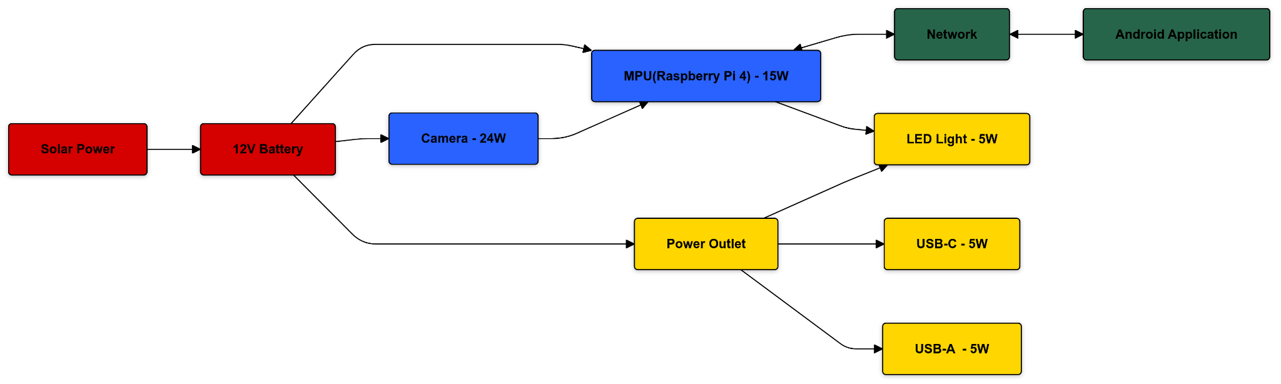
System Diagram
Red - Jackson Kitchel (Power Generation)
Yellow - Victor Igbokwe (Power Distribution)
Blue - Alex Allahar (Detection)
Green - Zayan Prasla (Network & Application)
Notes:
This is where task partition is stated, Alex

Slide 4
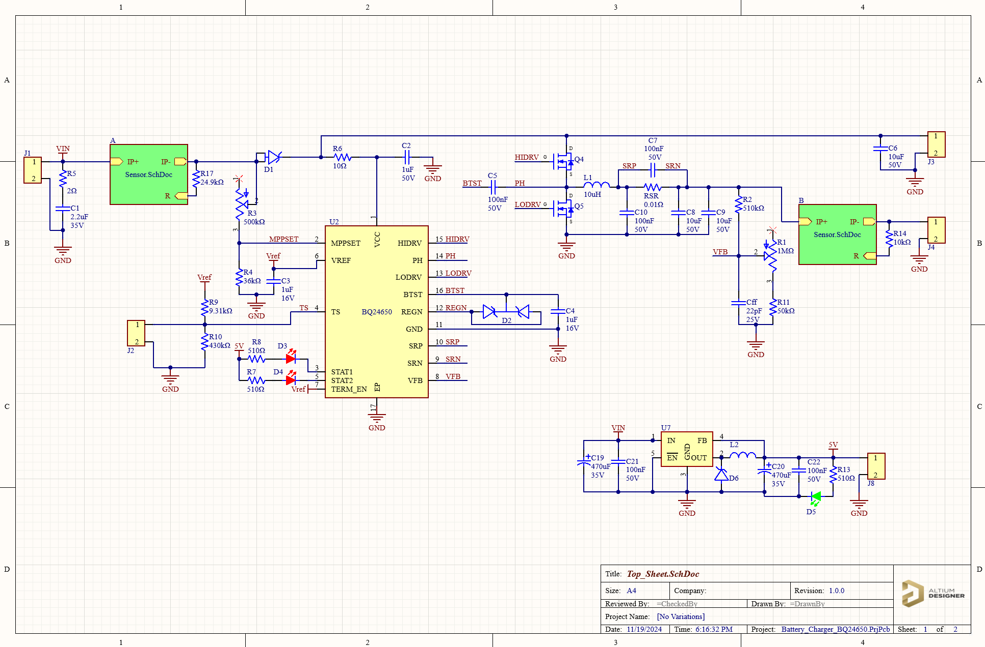
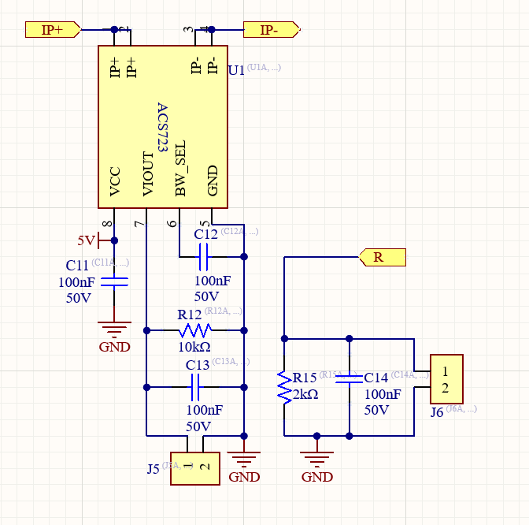
Subsystem 1: Power Generation
PCB responsible for power generation from the solar panel to the battery
Battery supplies power distribution PCP with 12V
Charging circuit automatically cuts on/off
Provides MCU with voltage and current readings at the solar panel and battery

Slide 5
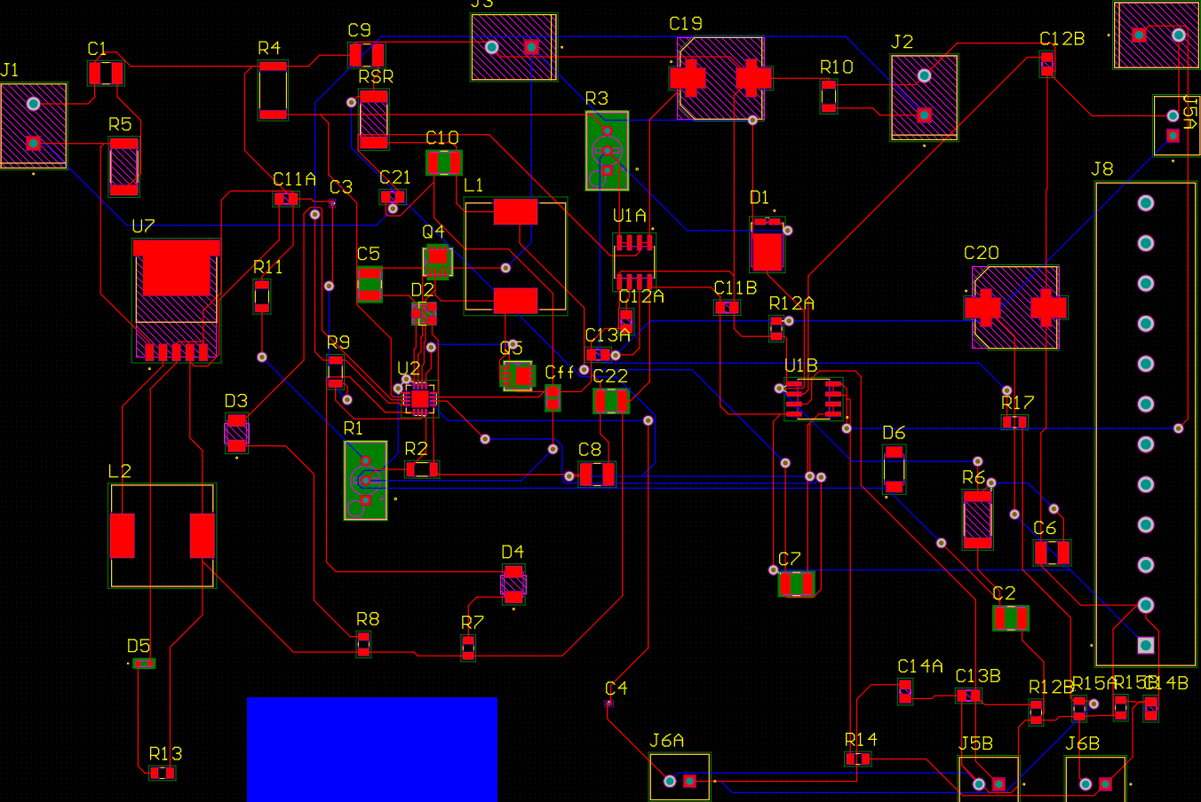
Subsystem 1: Power Generation
Ongoing Tasks:
First PCP scrapped
Soldering and testing PCB (ie. short circuit, continuity)
To do in 403:
Battery charging test
Cut on/off test
Demo
To do in 404:
Integrate power with distribution subsystem
Integrate voltage/current readings with MCU subsystem

Slide 6
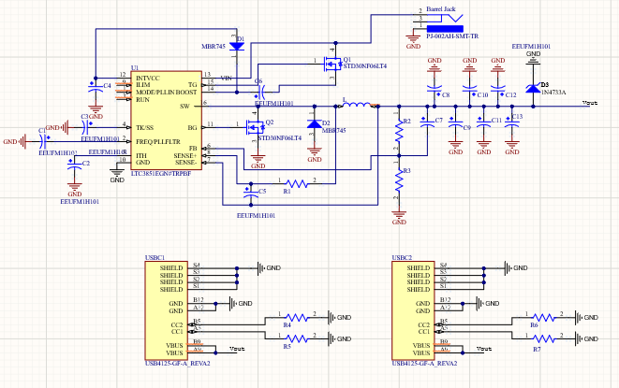
Subsystem 2: Power Distribution

Slide 7
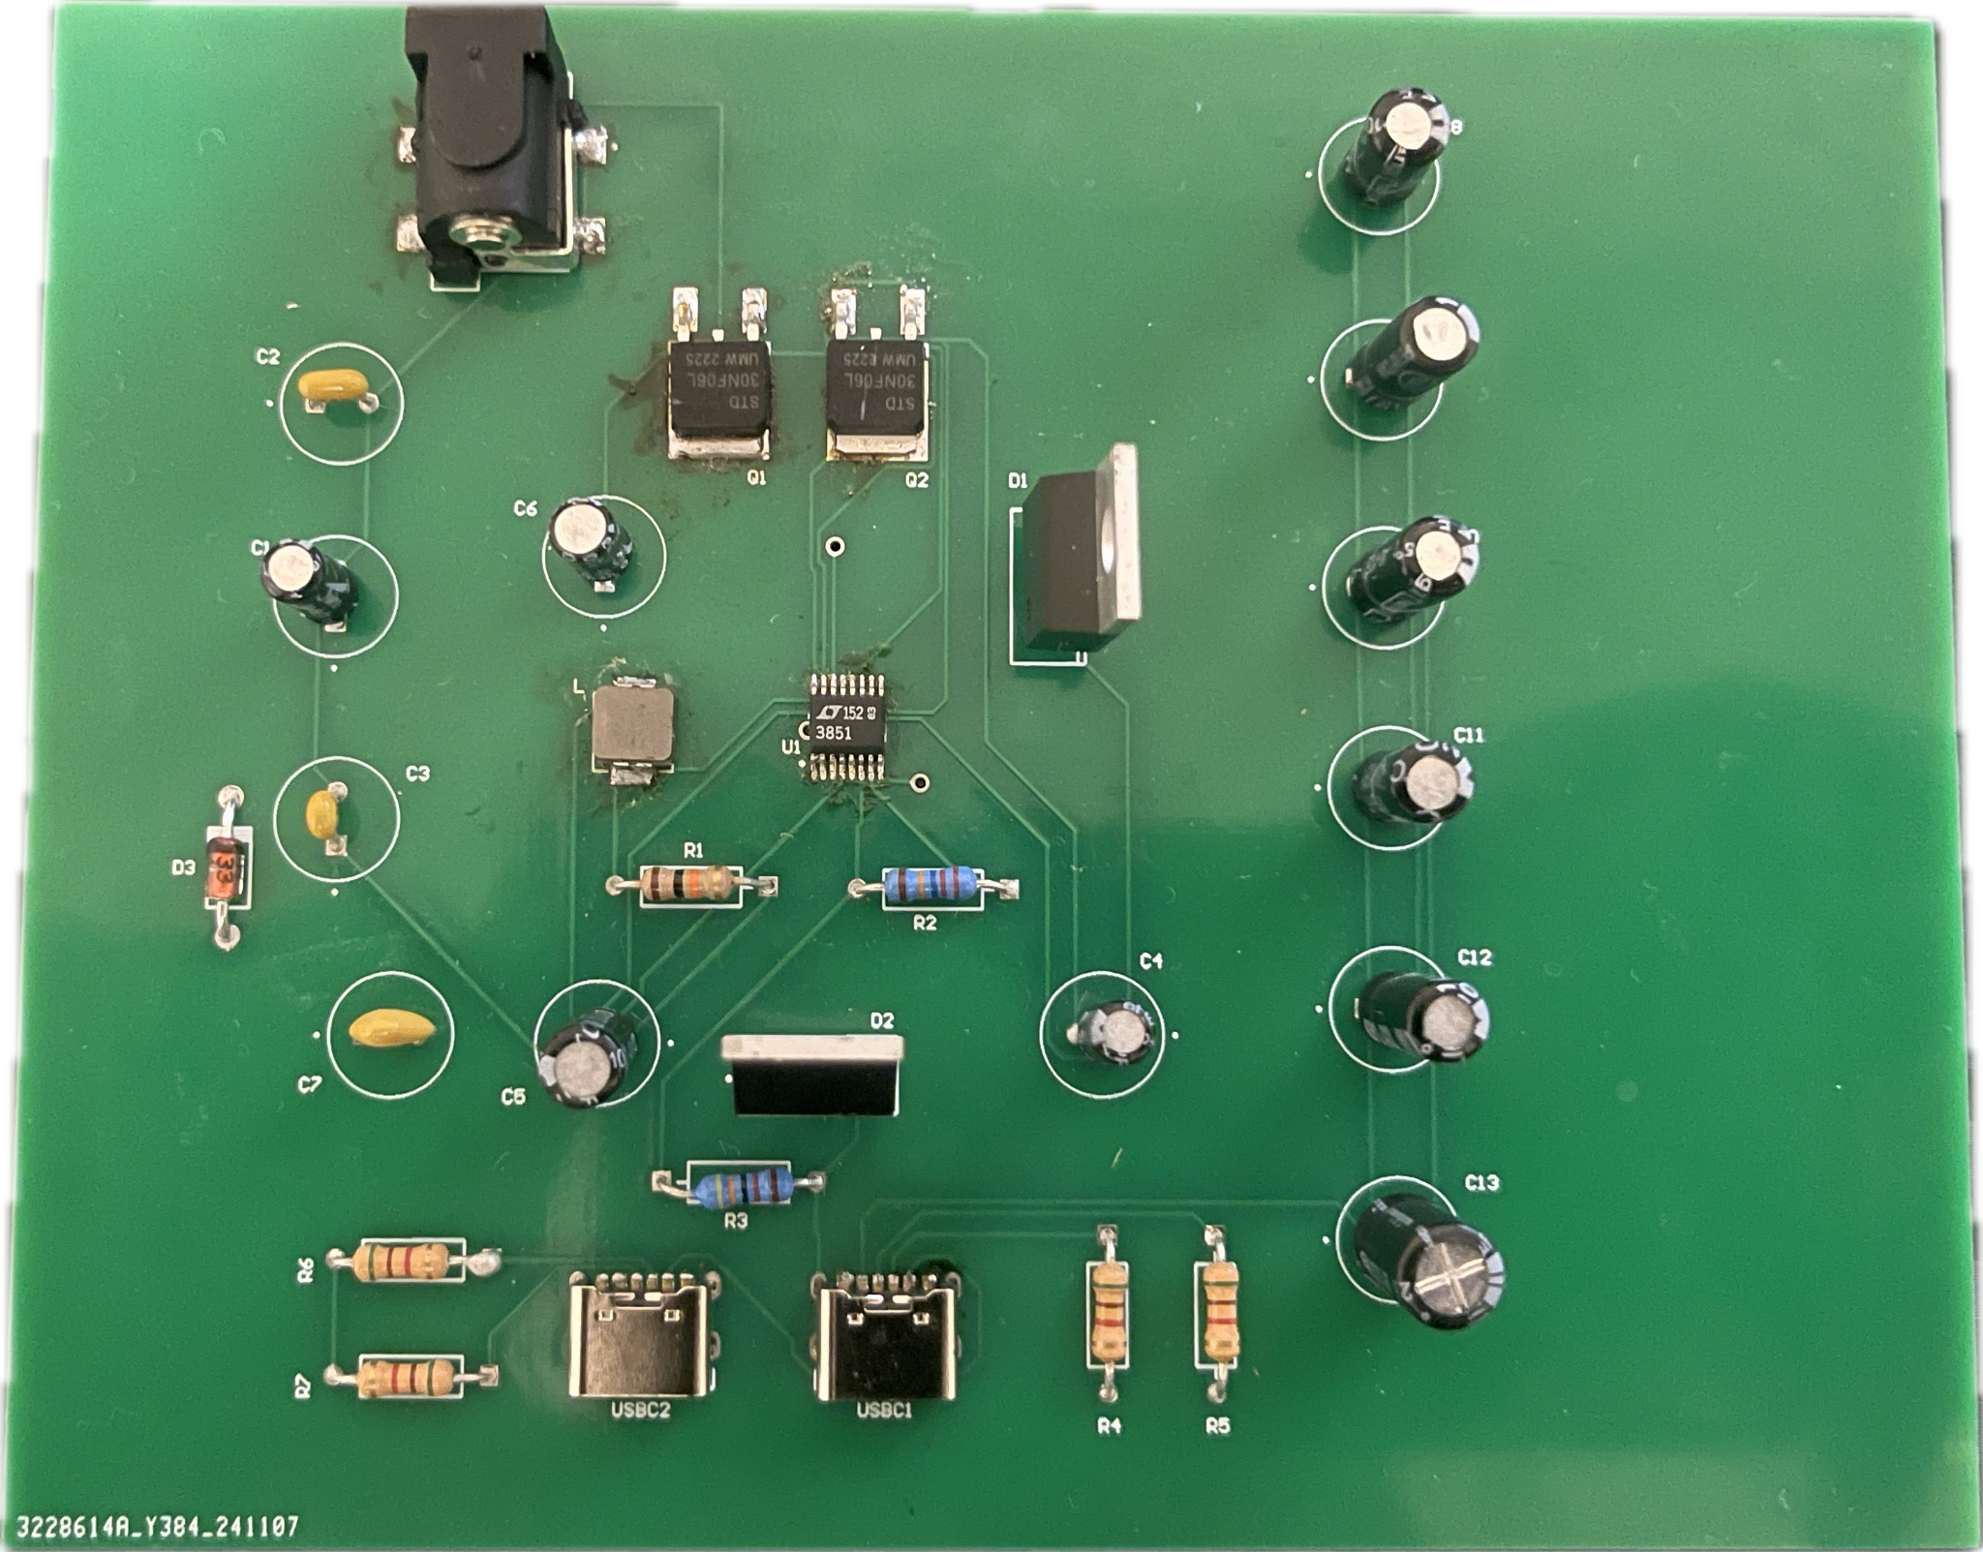
Power Distribution Cont.
Completed Tests
Continuity Test: Use a multimeter to check continuity between connected pads and traces to ensure no open connections exist.
Short Circuit Test: Verify there are no shorts between the power (5V and 12V rails) and ground. Measure resistance between 5V and GND and 12V and GND. It should not show a short (low resistance).
Concerns
Vin Connection: Experiencing difficulties with the connection between the MOSFET and the Vin pin of the IC chip.
Proposed Solution
Perf Board: Use an external Perf board to solder a connection between the mosfet and Vin.
To Do (403)
Output Voltage Test
Load Test
To Do (404)
Voltage Regulator load Components
Integration with other subsystems

Slide 8
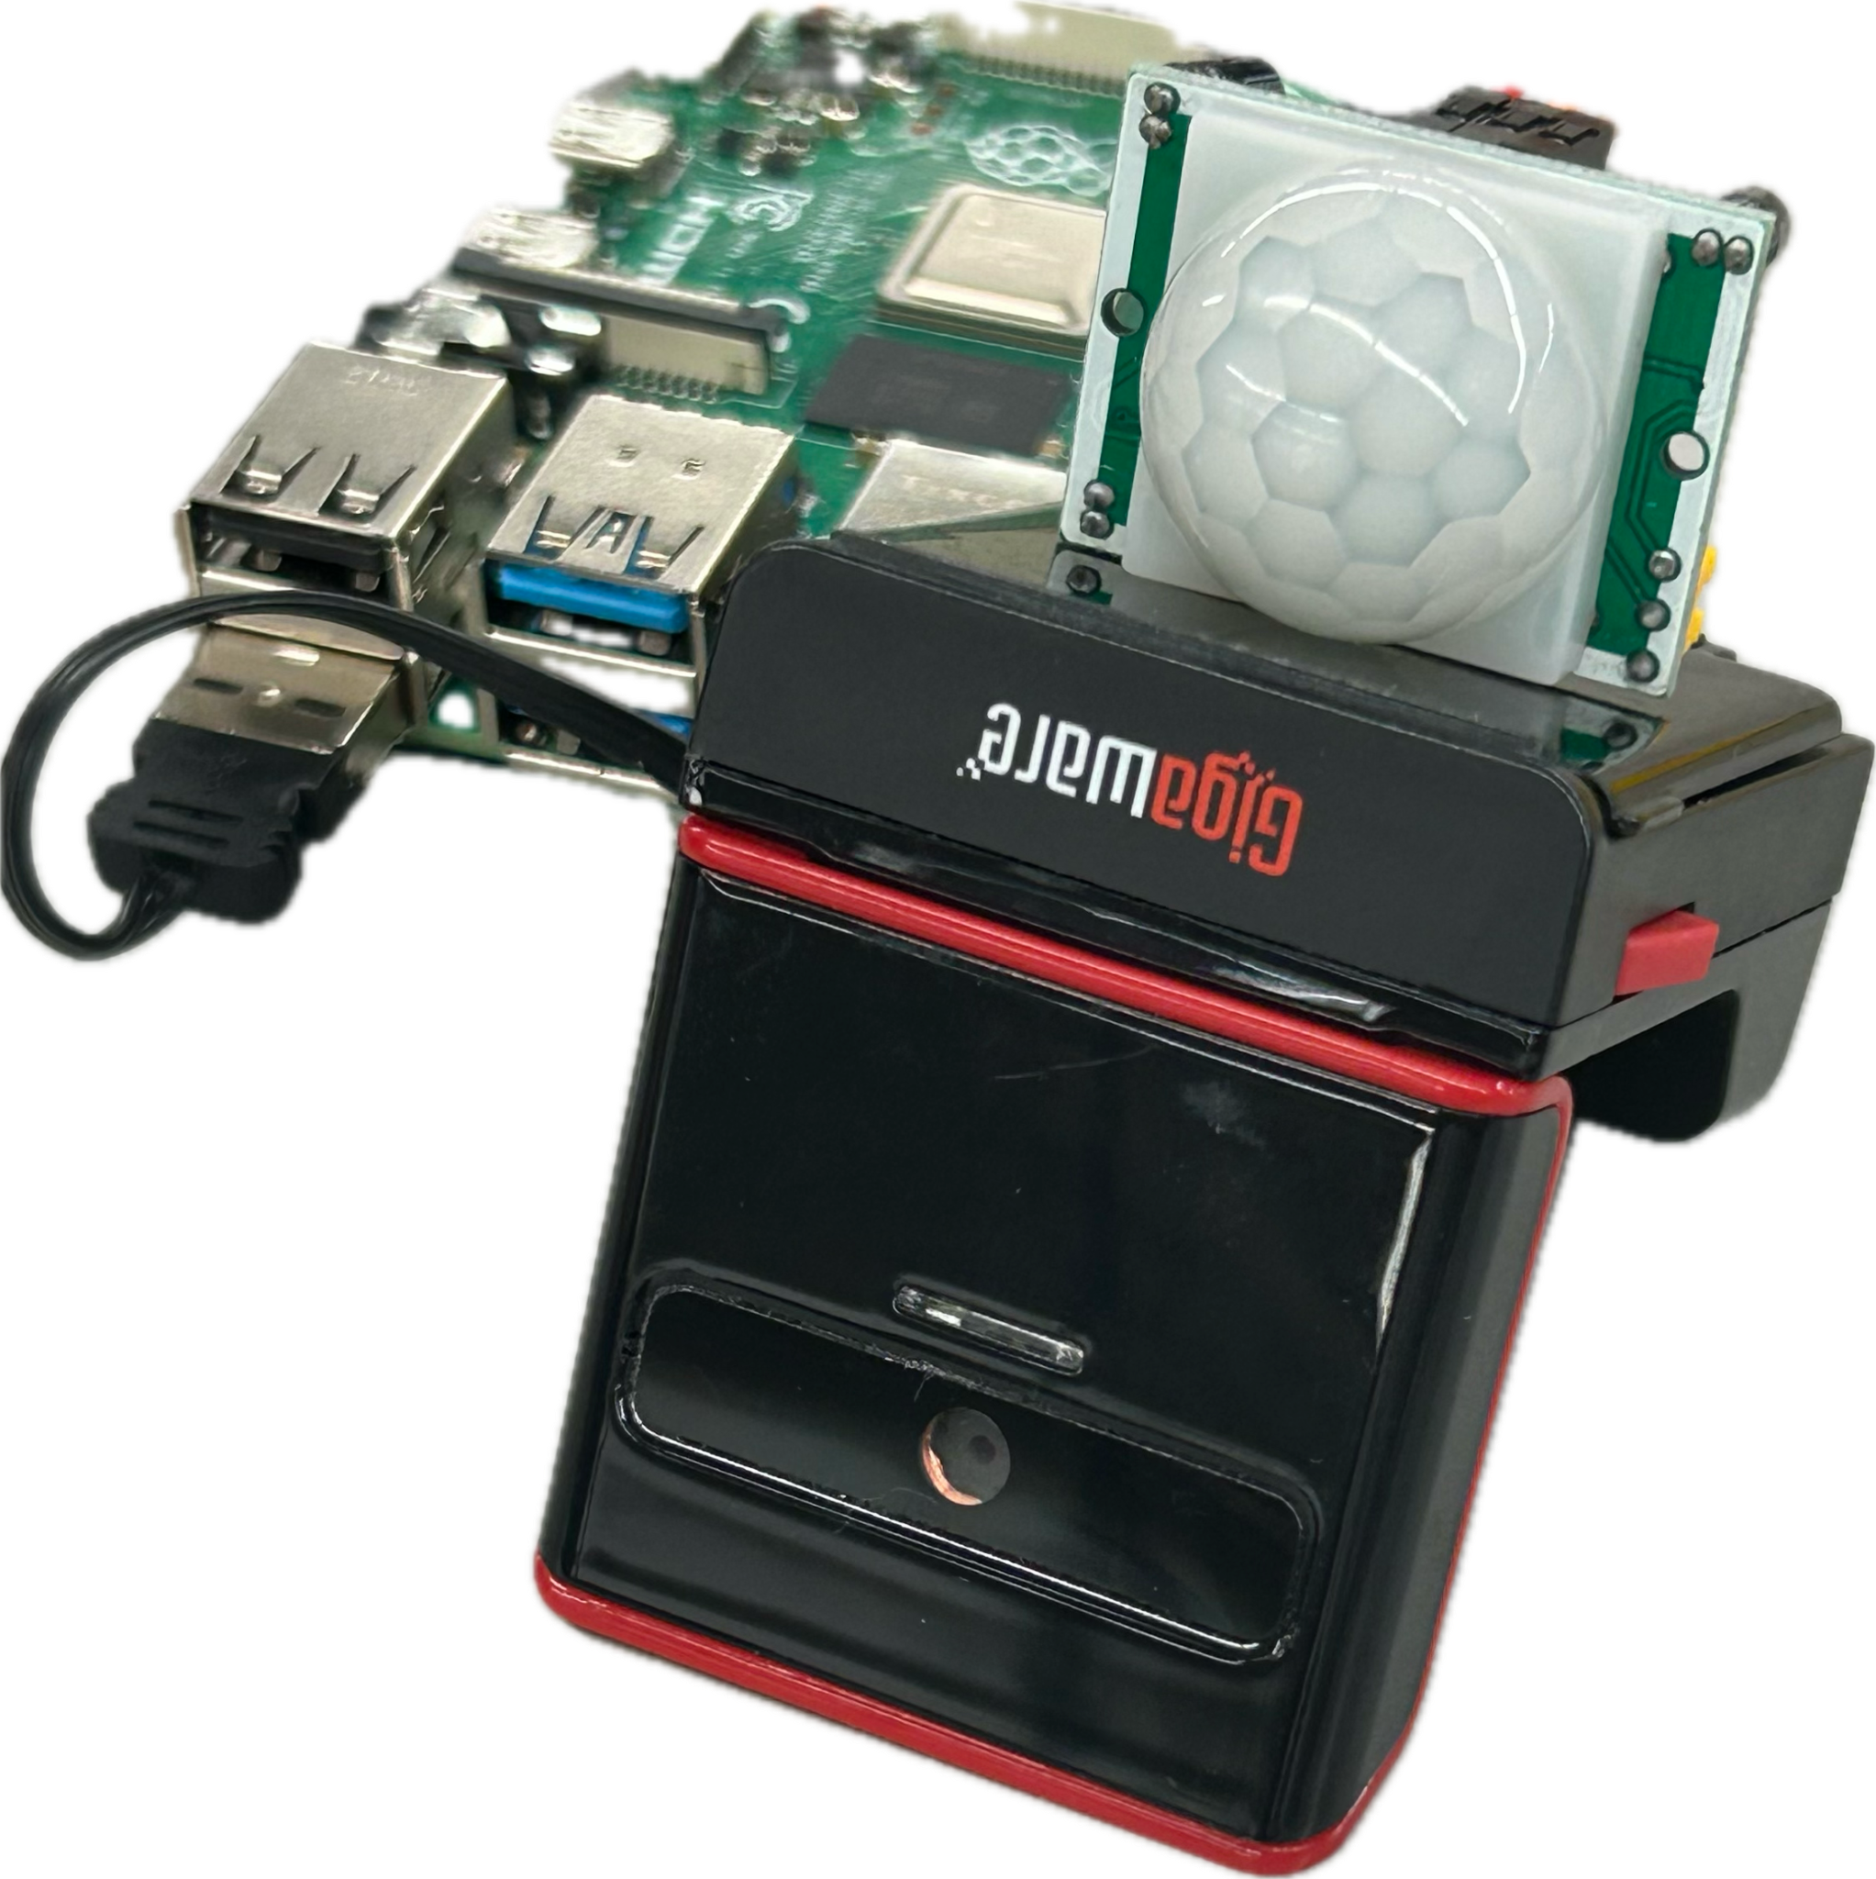
Detection: Modes of Operations
Low-Power Mode
Passive (Security)
PIR Sensor Activated
Automated Video Capture
Fixed / Variable
Generate Thumbnails
Local Event History
Store Footage on Firebase
Operational Mode
Active (Surveillance)
User Activated
Real-Time Video Stream
OpenCV Motion Detection
Send Alert to Firebase

Slide 9
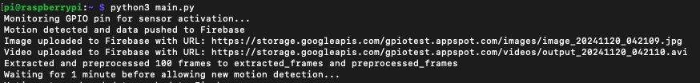
Detection: Test Cases
Completed:
Validate PIR Sensor functional up to 5 ft, FOV, with a FOV of 120°
Minimize delay between motion detection and video capture stored on Firebase.
Measure Raspberry PI Memory and CPU Usage during Modes of Operation.
To-Do (403):
Passive Mode Output

Slide 10
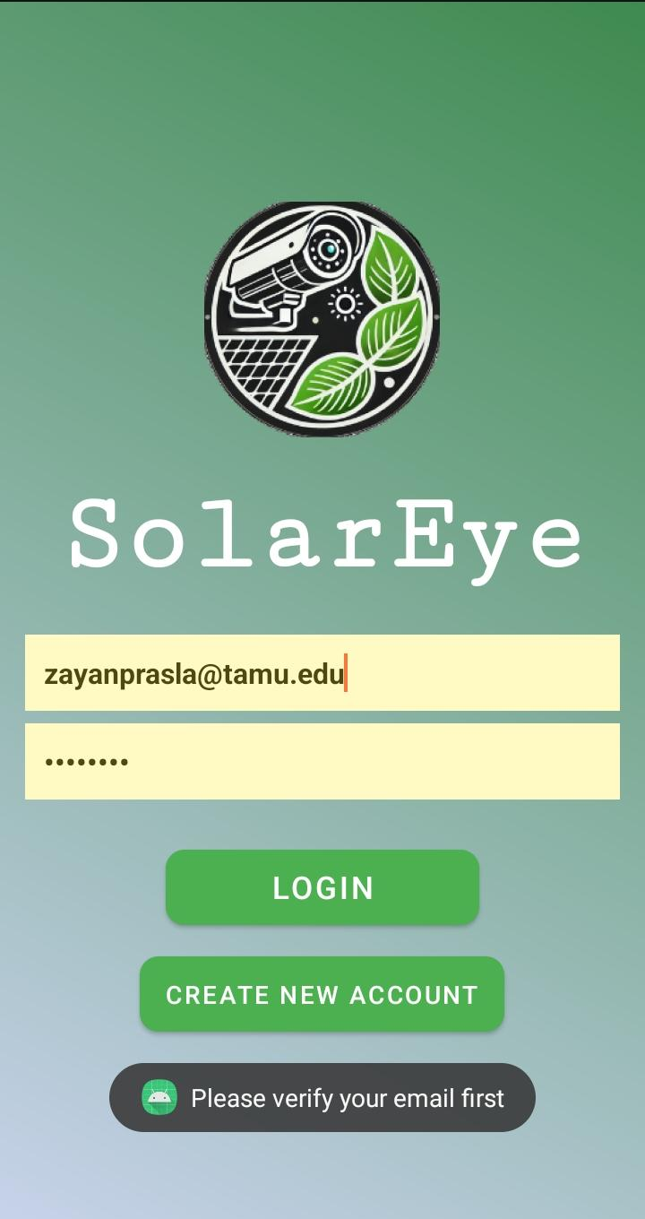

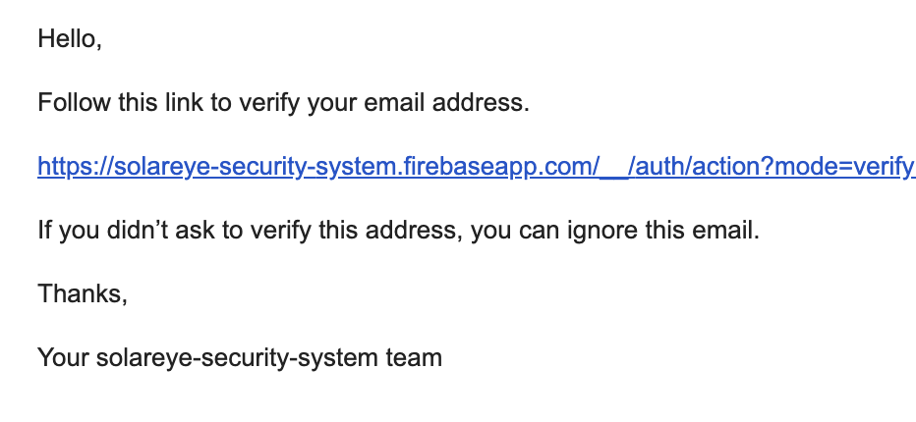
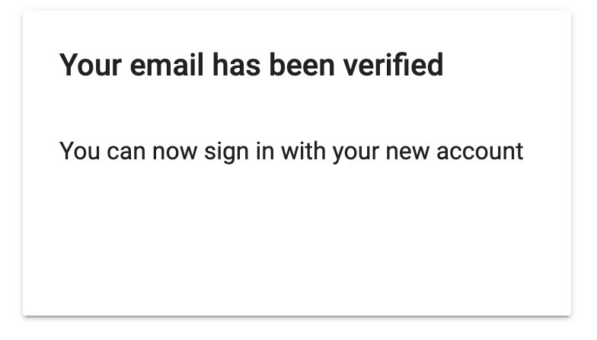
Subsystem 4: Software/App
Login Page:
User Login saved on Firebase Auth
Email must be verified to login
User remains logged in until they manually log out
Account Creation:
Email Verification
Verification Link expiration
Password Policy
Email Verification:

Slide 11
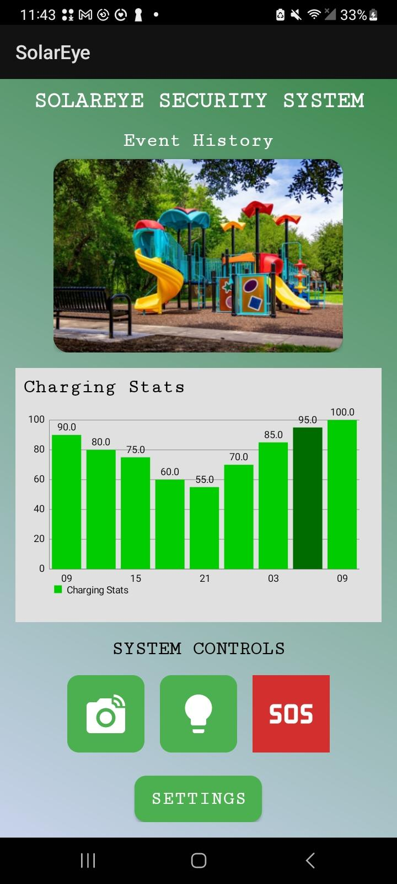
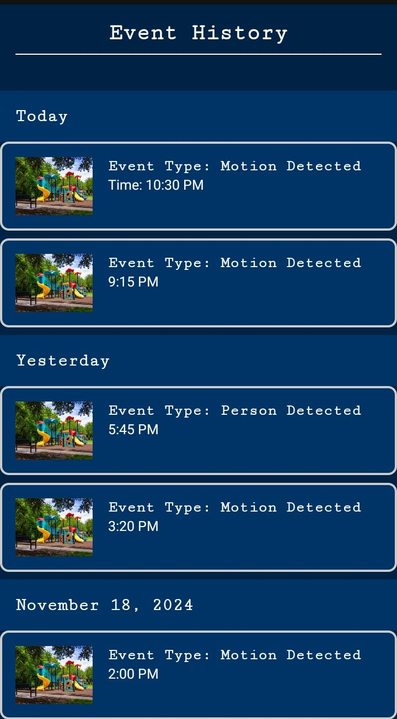
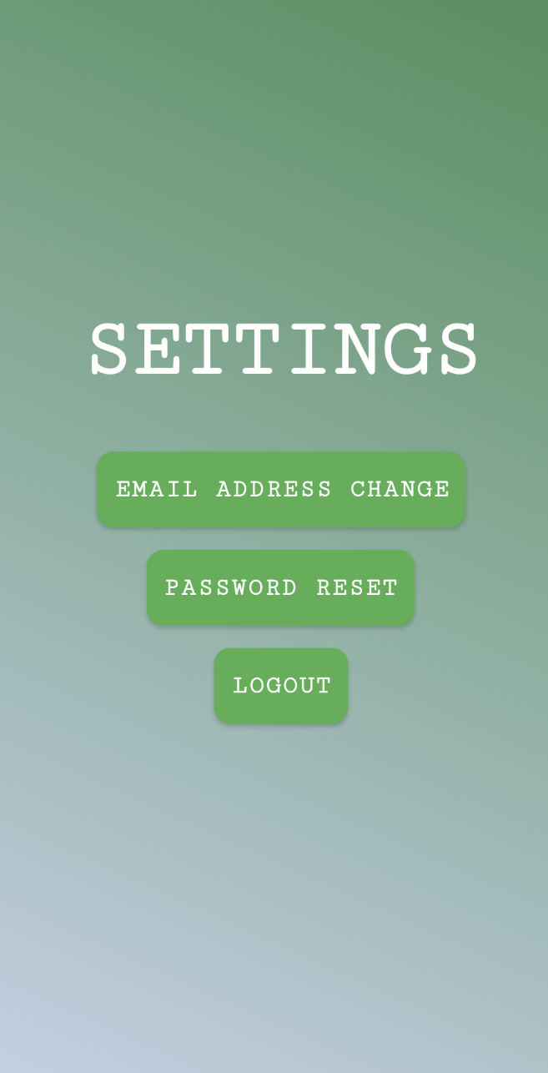
Subsystem 4: App Main Page
Main Page:
Latest thumbnail displayed
Charging Statistics
System Controls
Event History:
Events sectioned by date recorded
Event Type and Time
Settings:
Log Out
Email Change
Password Reset

Slide 12
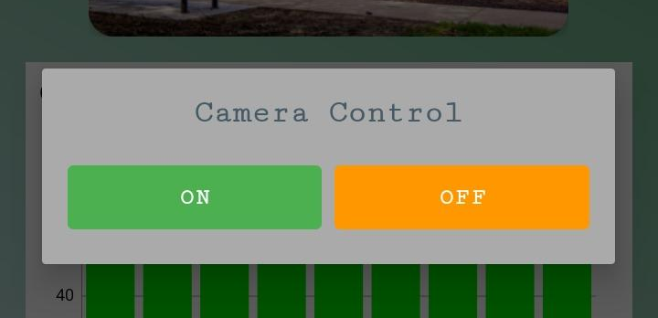

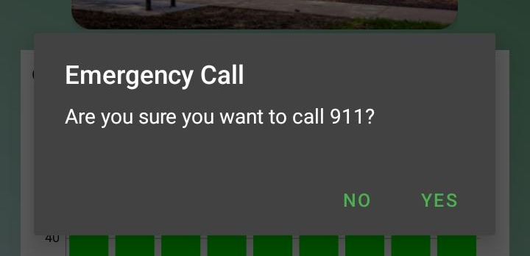
Subsystem 4: App System Controls
On/Off controls for Camera and LED Light (not yet connected)
SOS Emergency Call (connected directly to device)

Slide 13
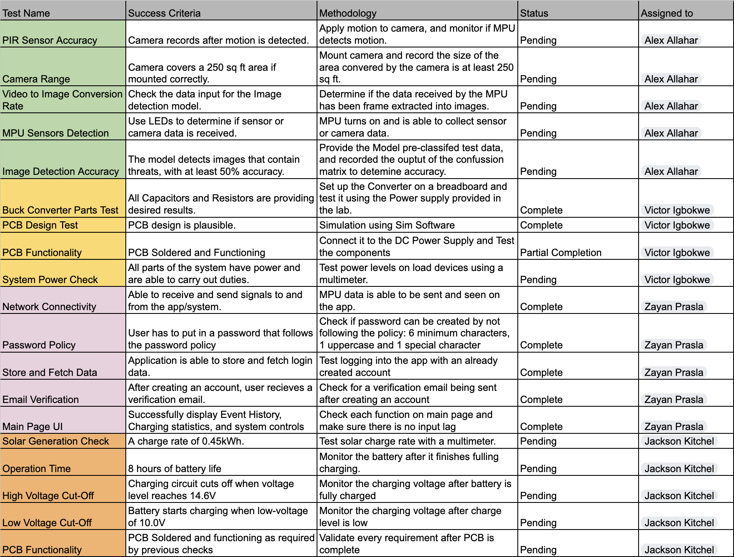
Execution and Validation Status

Slide 14
Remaining Tasks
Summarize what remains to be completed for your subsystem design, assembly, test, and validation by Project Demo date.
Summarize what key design activity from each subsystem will be completed in 404 (eg. fabrication and assembly of final PCB, full ML model training, in-situ sensor calibration, enclosure design and fabrication, mount 3d-printing)
Software: FAQ section is left. In 404 the app will be connected to the security system, retrieve live data from Firebase Firestore, and have a better front User Interface.
Microprocessor/Detection:
Power Generation:
Power Distribution:

Slide 15
